Slide 1
FULLSTOCK
Team 8: Cameron Nguyen, Nathan Carney, Rachel Freedman, and Sam Song

Slide 2
Development Recommendation
Custom Development
Business need is unique
Get exactly what we want
Build technical skills and functional knowledge
Allows team flexibility and creativity

Slide 3
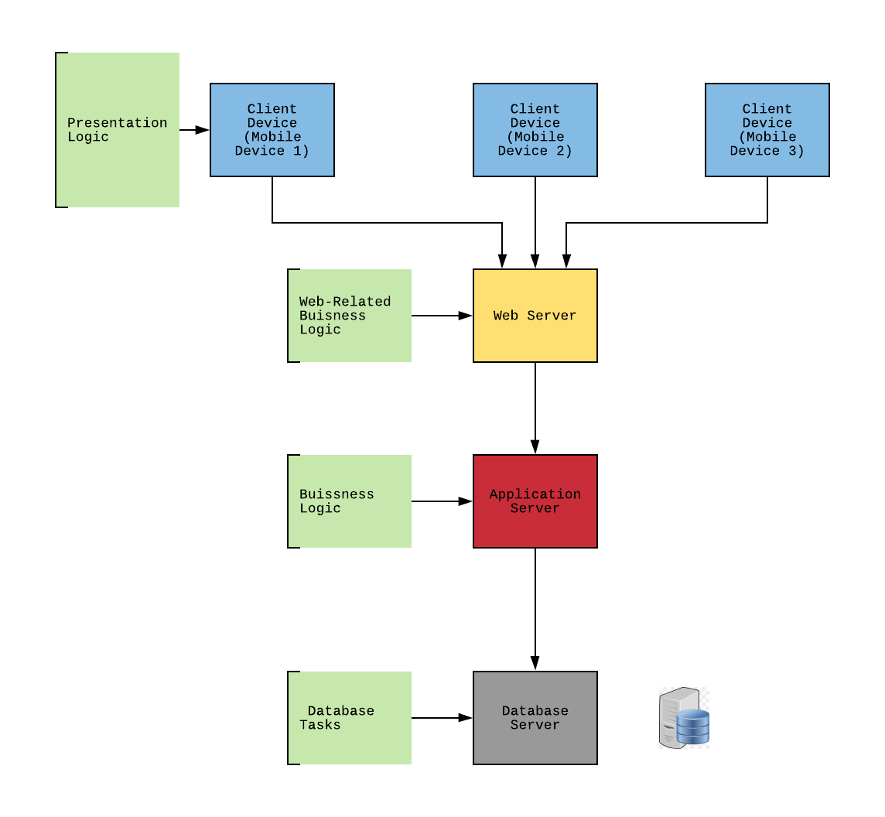
Client / Server Architecture

Slide 4
Architecture Design
SECURE
ACCESSIBLE
FAST AND RELIABLE
N-tiered : Scalability + E-Commerce
Thin:
Operational requirements - vast portability
Performance - scalable + “crash protected”
Security - Advanced authentication tools
Cultural and Political - Restaurant Industry +diversity

Slide 5
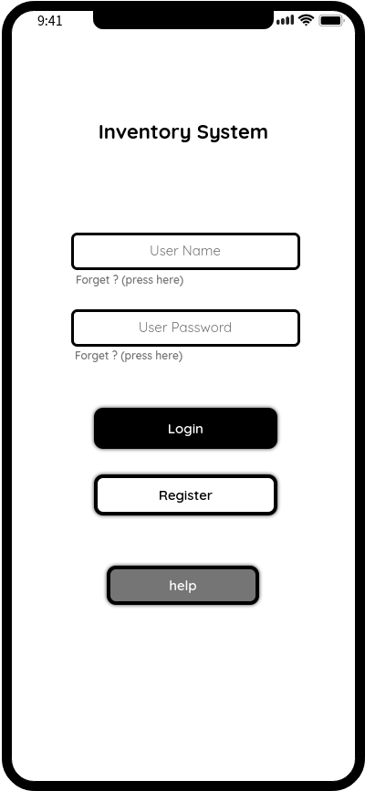
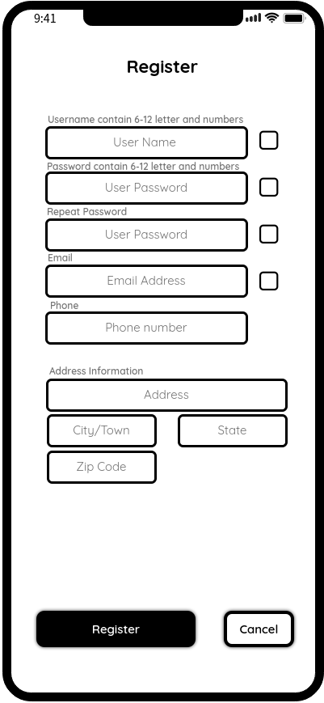
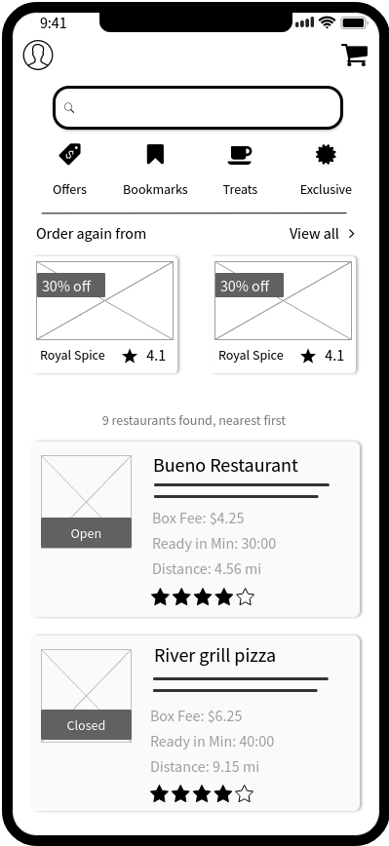
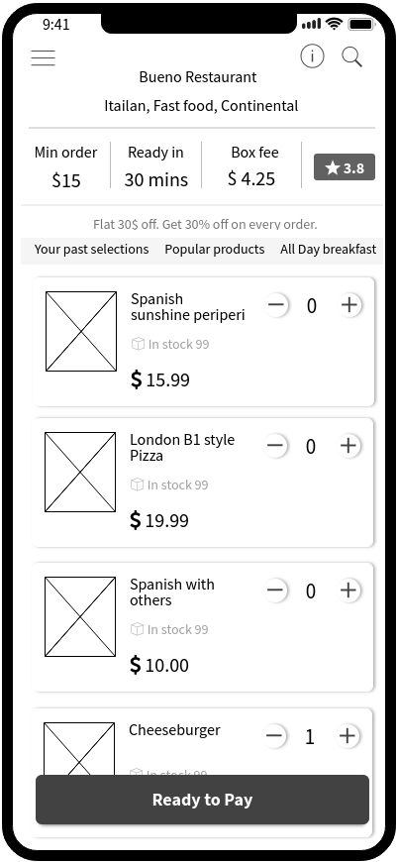
User Interface - Customer
Home Page
Register Page
Search Page
Menu Page

Slide 6
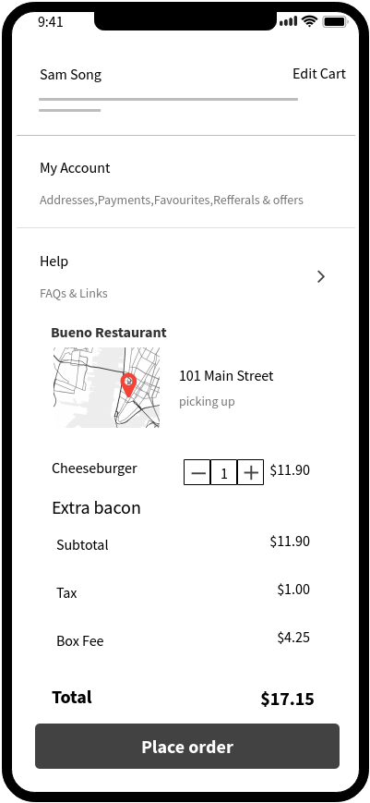
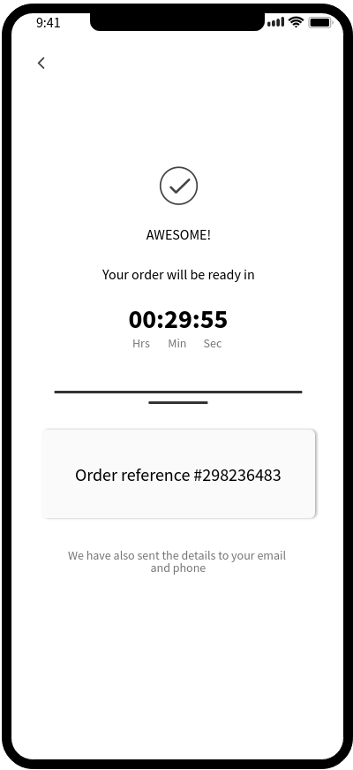
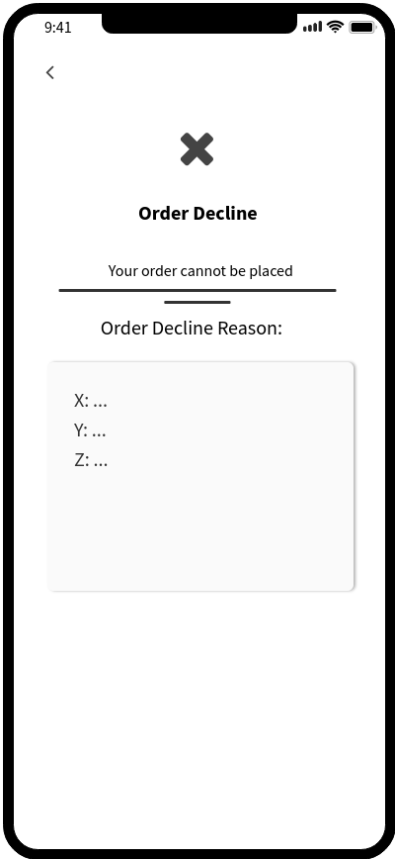
User Interface - Customer
Payment Page
Result Page

Slide 7
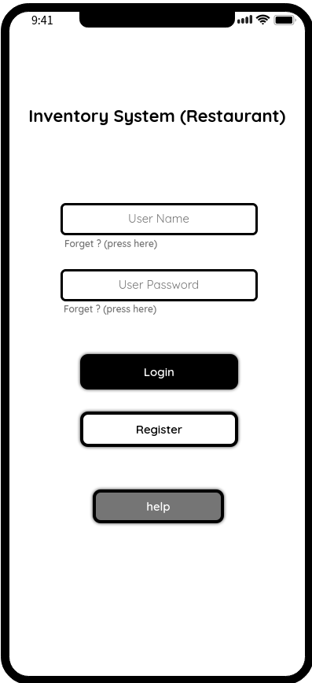
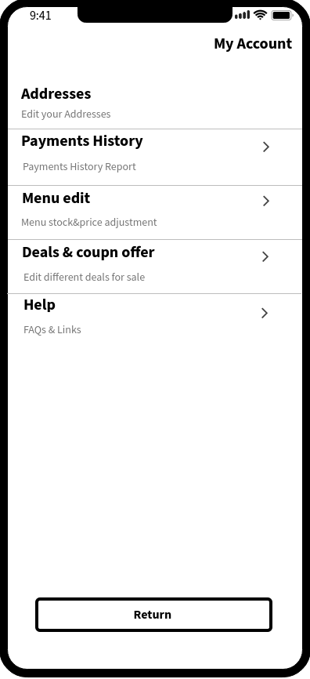
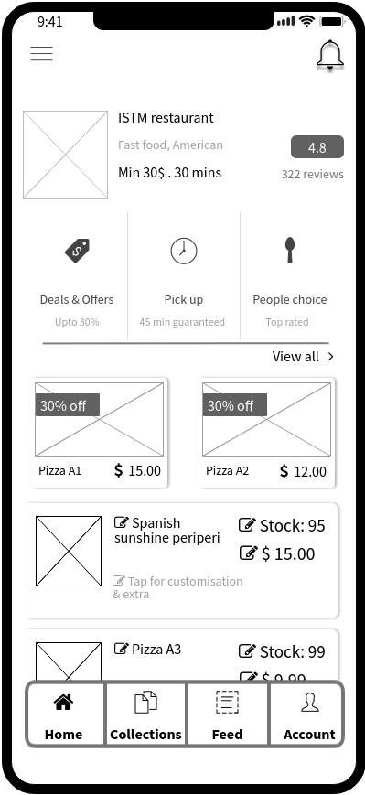
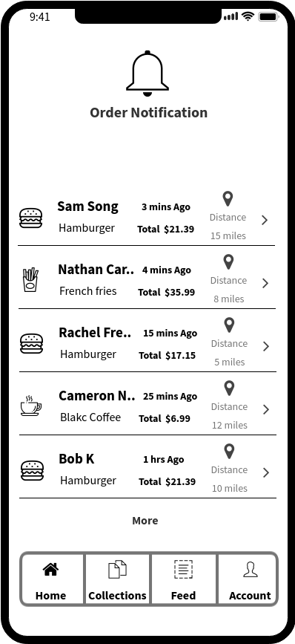
User Interface - Restaurant
Home Page
Account Page
Menu Edit Page
Notification Page

Slide 8
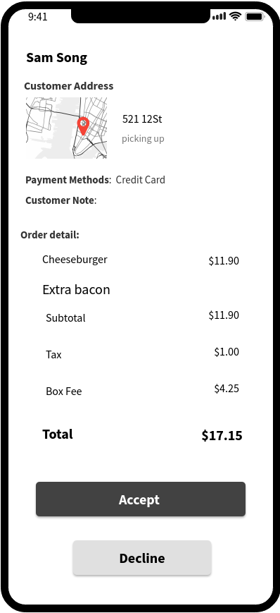
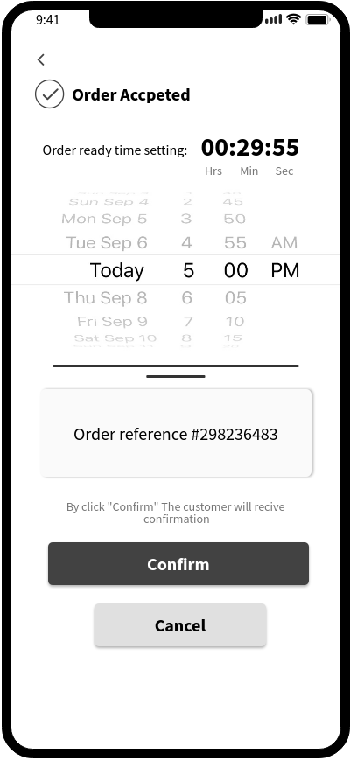
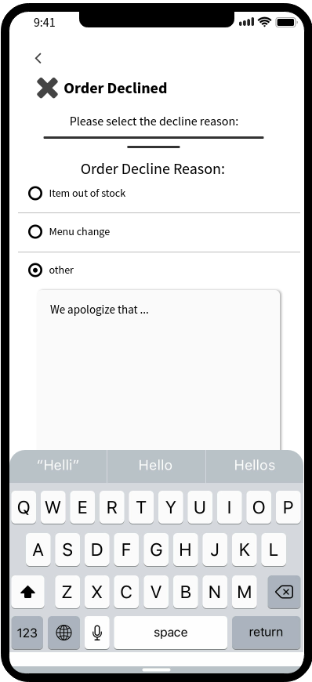
User Interface - Restaurant
Order Detail Page
Decision Pages

Slide 9
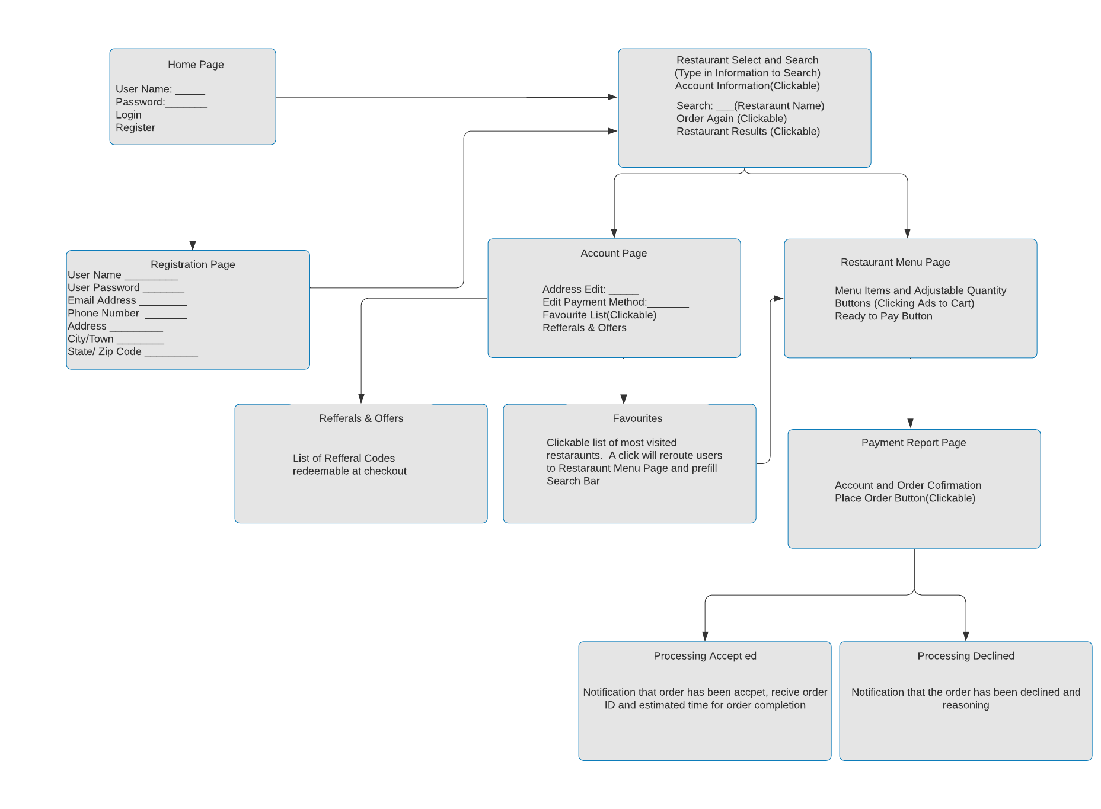
Storyboard - Customer Journey

Slide 10
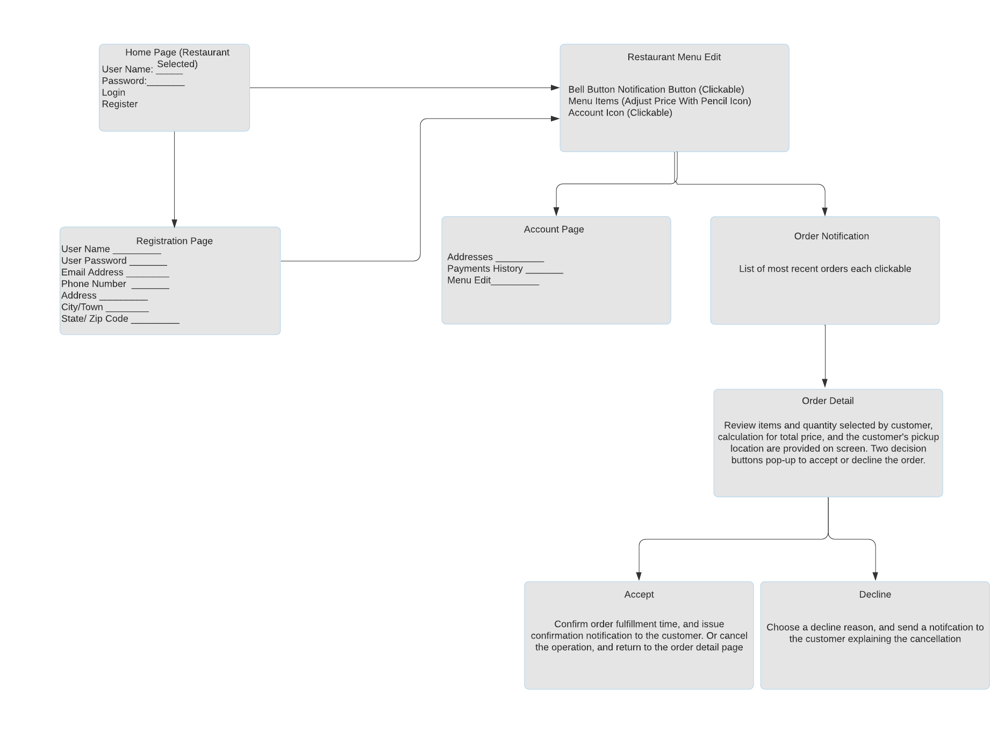
Storyboard - Restaurant Journey

Slide 11
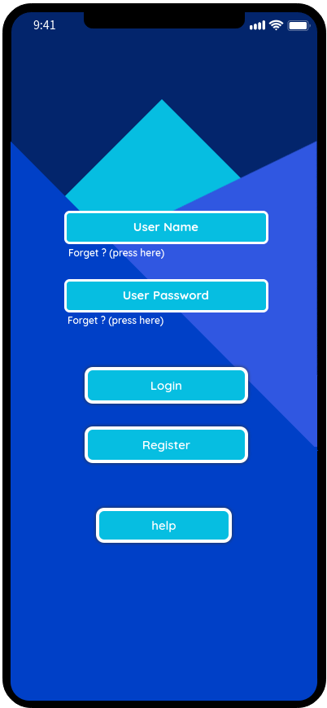
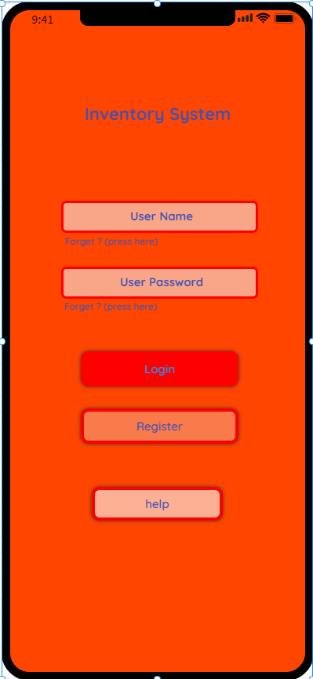
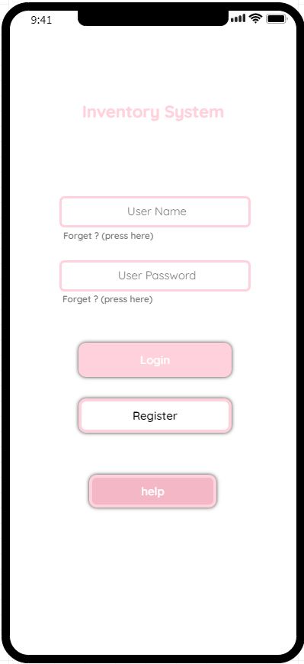
More Colors

Slide 12
Thank You!

